Slide 1
ADK Laurentian Chapter
2022 Photo Contest Winners

Slide 2
Contest Judges
  Jean Giblin
  Jeanna Matthews
  Andy Rawdon
Organizer
  Tom Ortmeyer

Slide 3
Landscape Honorable Mention
Osgood Put In
Holly Chorba

Slide 4
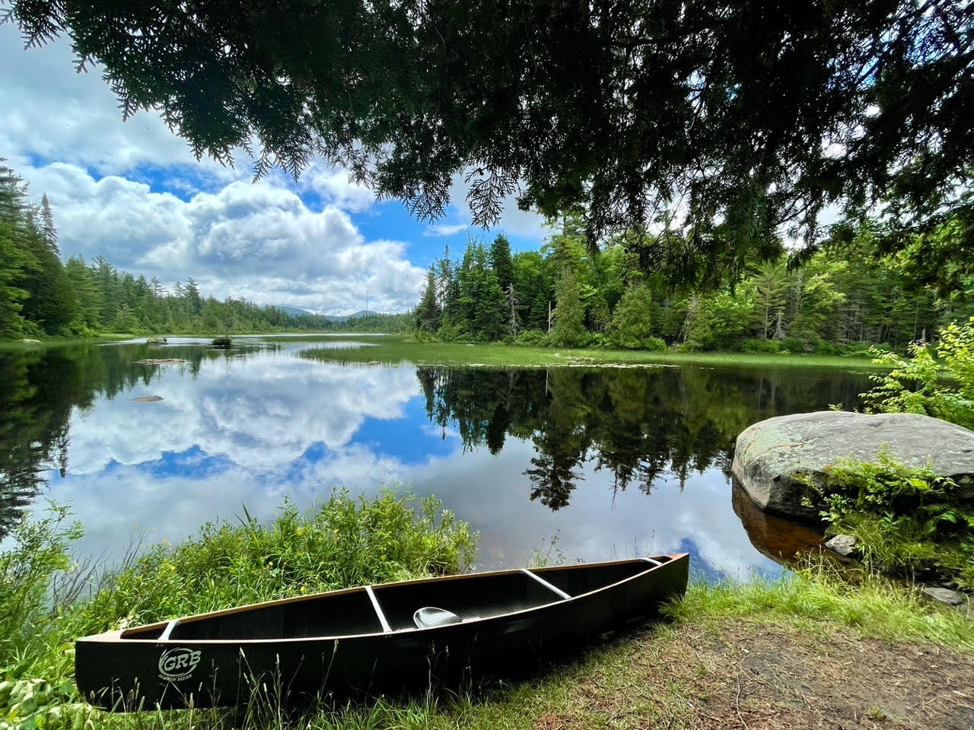

Slide 5
First Prize, Landscape
Dug Mountain Autumn
Bob Platte

Slide 6
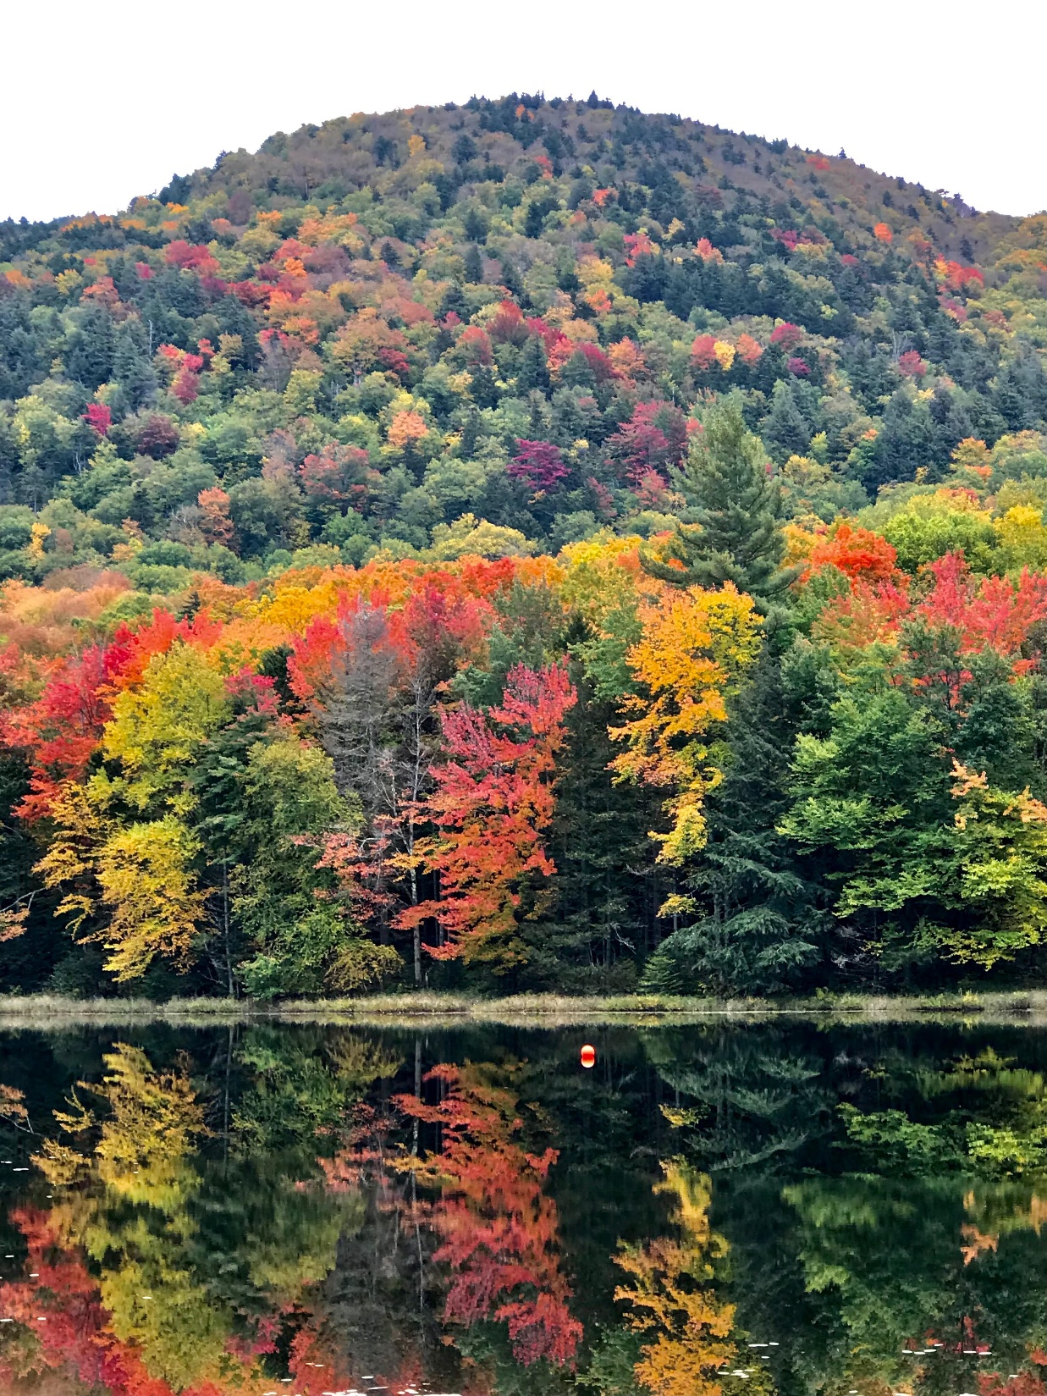

Slide 7
People Honorable Mention
Exchange Student’s First Snowshoe Adventure
Jeff Miller

Slide 8
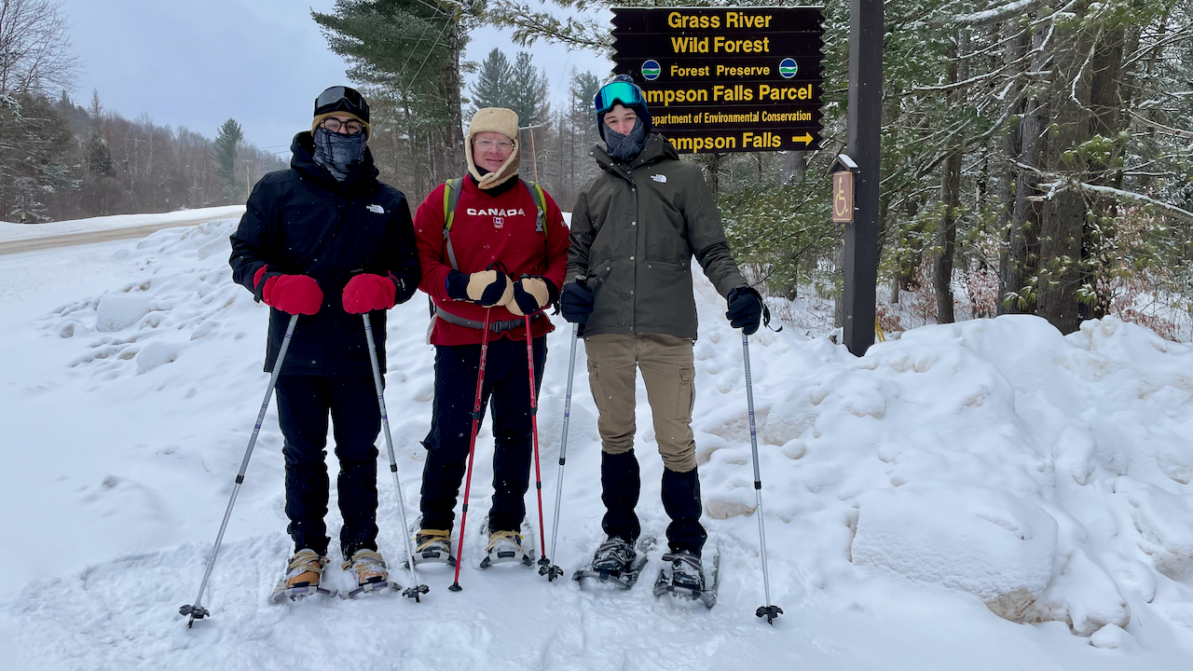

Slide 9
First Prize, People
Clarksboro Trail 6/5/22
Marianne Hebert

Slide 10
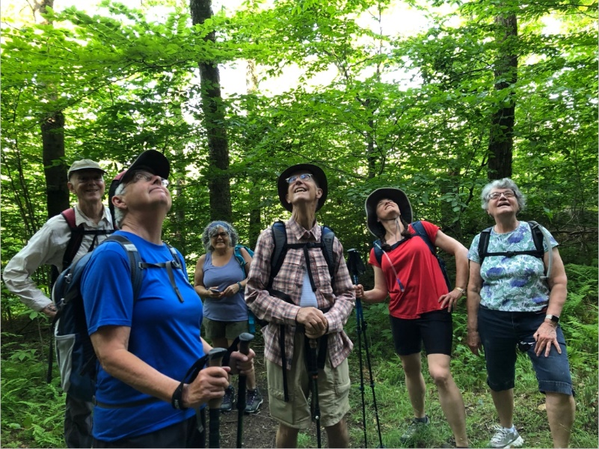

Slide 11
Nature Honorable Mention
Nature Always Wins
Jeff Miller

Slide 12
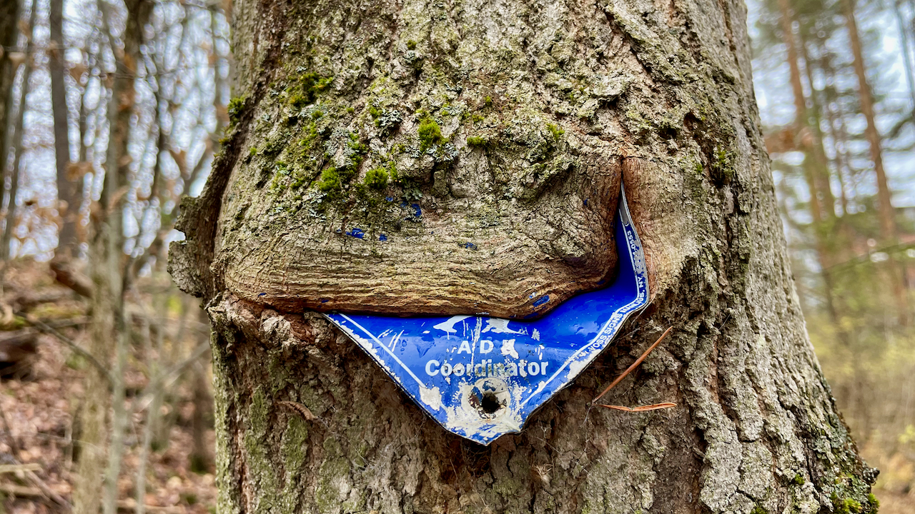

Slide 13
First Prize, Nature
Upper and Lower Lakes 9/22
Holly Chorba

Slide 14
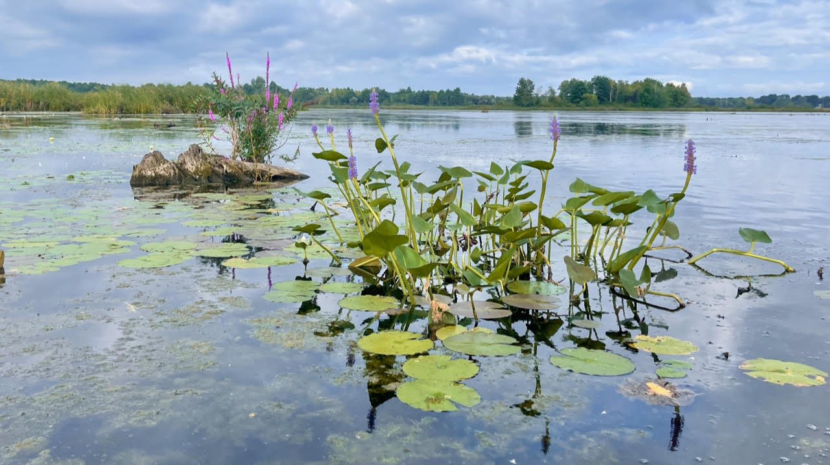

Slide 15
Action Honorable Mention
Anchors Aweigh! Lower Lock Saranac River
Cynthia Grover

Slide 16
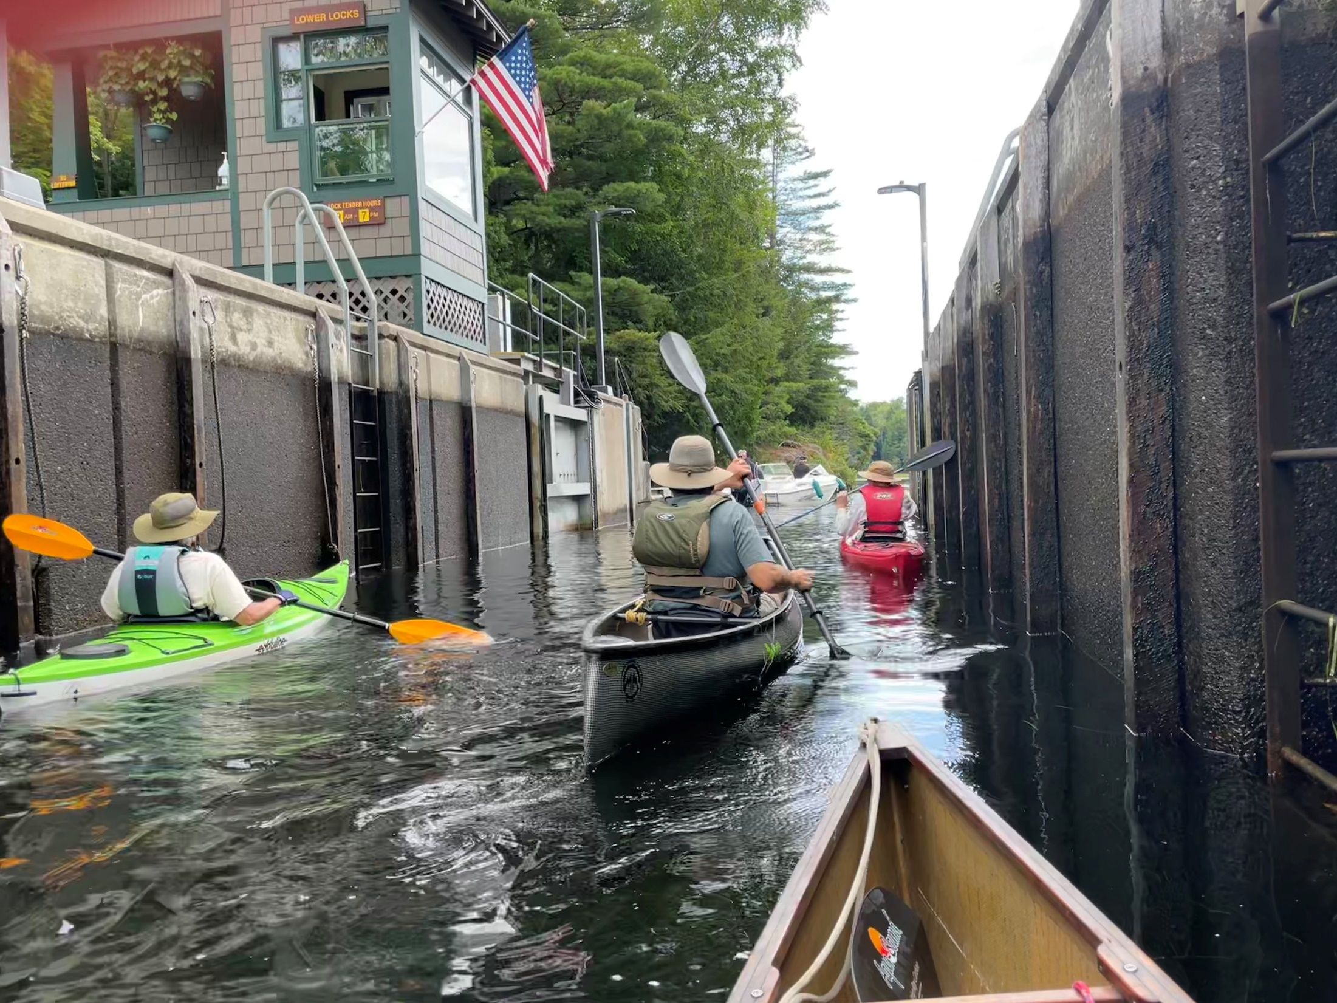

Slide 17
First Prize, Action
Saranac River
Holly Chorba

Slide 18
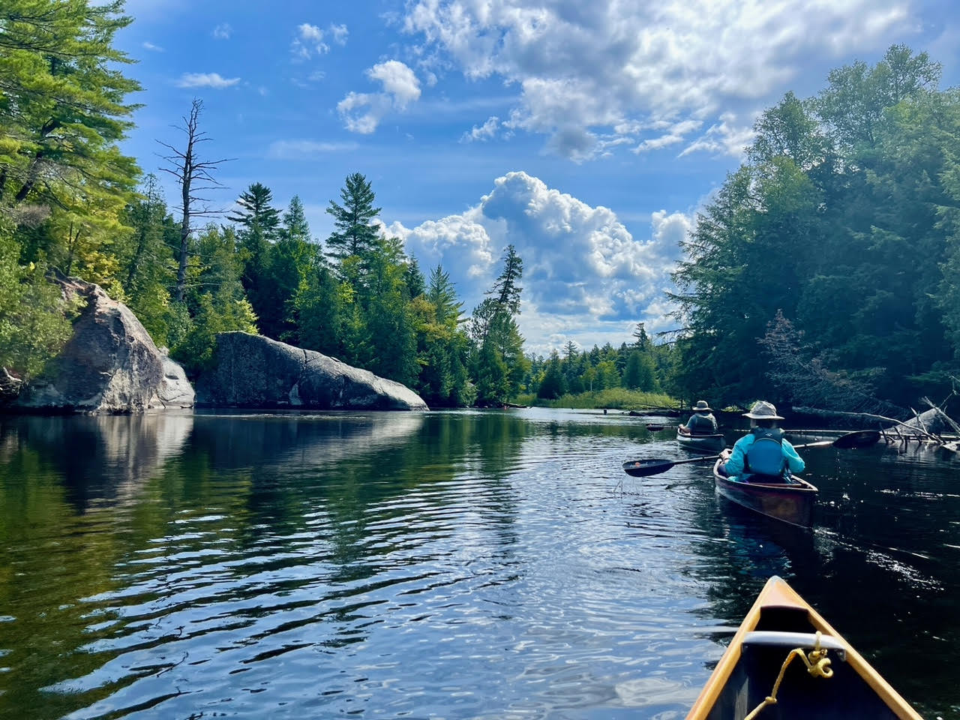

Slide 19
Artistic Honorable Mention
Yellow Garden Spider
Bob Platte

Slide 20
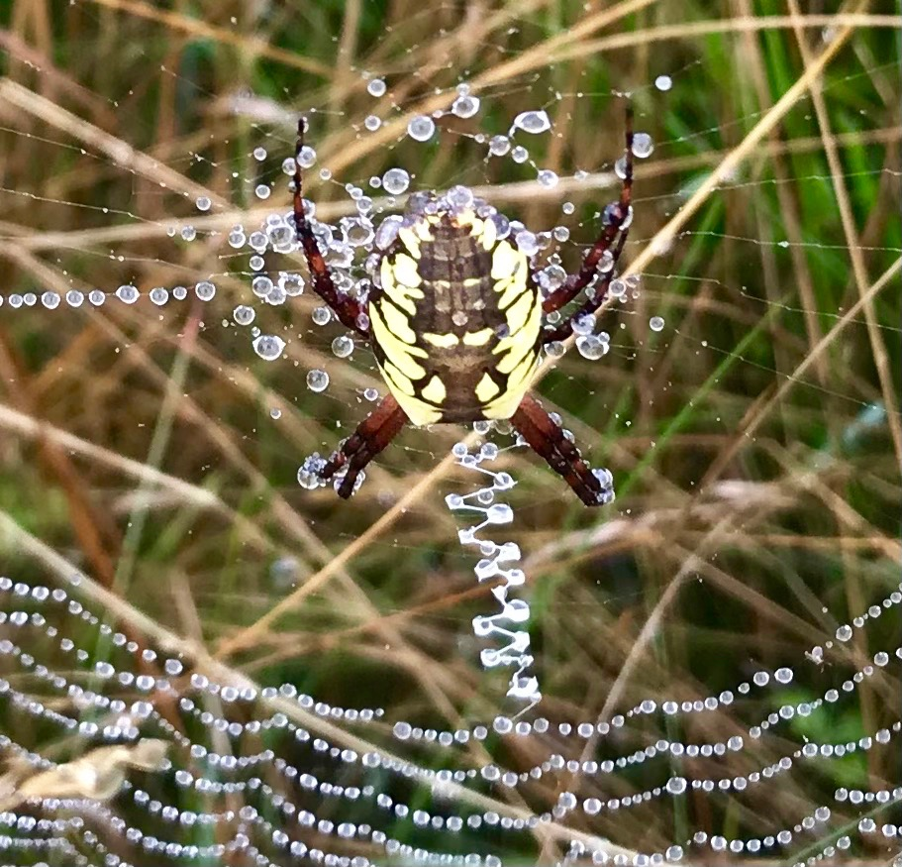

Slide 21
First Prize, Artistic
Jakeway Falls Nicholville
St. Regis River
Duncan Cutter

Slide 22
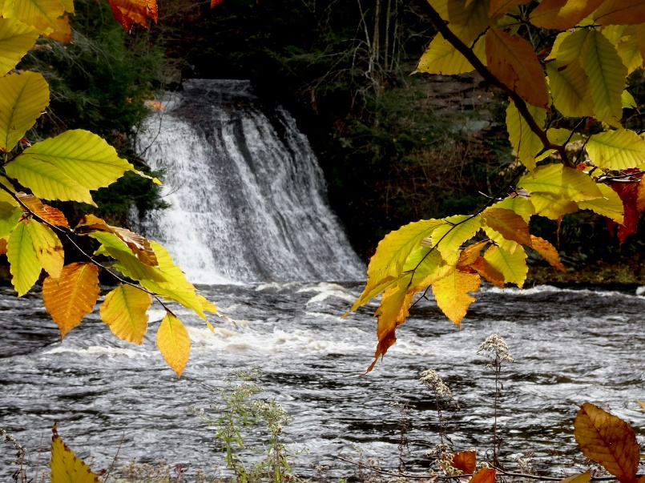

Slide 23
Grand Prize
Along Dead Creek Flow Trail 11/16/21
Holly Woodworth

Slide 24
